Slide 1
Edge Detection

Slide 2
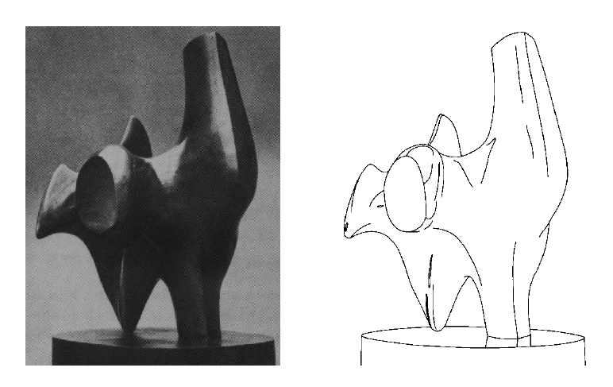
Edge Detection
Convert a 2D image into a set of curves
Extracts salient features of the scene
More compact than pixels
Notes:
Edge detection is a process of locating an edge of an image. Detection of edges in an image is a very important step towards understanding
image features. Edges consist of meaningful features and contain significant information. It significantly reduces the image size and filters
out information that may be regarded as less relevant, thus preserving the important structural properties of an image

Slide 3

Origin of Edges
surface normal discontinuity
depth discontinuity
surface color discontinuity
illumination discontinuity
Edges are caused by a variety of factors
Notes:
Now let us take a look at some of the physical phenomena in the real world that cause edges in images. If one object is located in front of another, there will likely be a sudden change in intensity along the boundary between the two objects. We refer to these as edges that result from a discontinuity in depth. Even if two surfaces are made of the same material, if they have different surface orientations where they meet, they will likely receive different amounts of light from the light sources in the scene, and hence have different brightness values. We refer to these edges as arising from a discontinuity in surface normal. Additionally, if the surface is marked, such as the letters on the bottle here, it will have surface reflectance (material) discontinuities, that again result in edges. Finally, we can have shadows, or illumination discontinuities. Here, the bottle casts a sharp shadow on the background, resulting in a significant difference in the amount of light falling within and outside the shadow. This, again, gives rise to edges.

Slide 4
How can you tell that a pixel is on an edge?
Notes:
Using their intensity values

Slide 5


Edges
Edges are those places in an image that correspond to object boundaries.
Edges are pixels where image brightness changes abruptly.
Brightness vs. Spatial Coordinates
Notes:
Binary image n gray scale images
Pixels on edge = pixels on object not backgrounds

Slide 6
Edge Types
Step Edges
Roof Edge
Line Edges
Notes:
Convex, Concave, bar edges
Another classification : Horizontal edges, Vertical Edges, Diagonal Edges

Slide 7
Methods in Matlab
Prewitt Operator
Sobel Operator
Robinson Compass Masks
Krisch Compass Masks
Laplacian Operator.
Notes:
Prewitt operator is used for detecting edges horizontally and vertically. / Sobel
Robinson all 8 compass major directions / Krisch
Laplacian – negative and positive laplacian masks re there. So some cover hor. And vert. / one direction / all direction

Slide 8
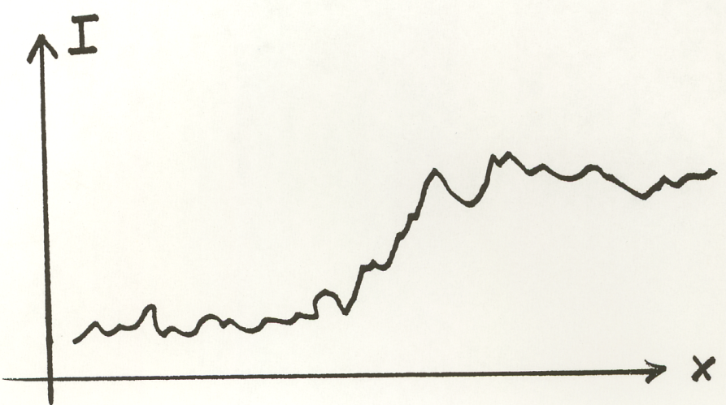
Real Edges
Noisy and Discrete!
We want an Edge Operator that produces:
Edge Magnitude
Edge Orientation
High Detection Rate and Good Localization
Notes:
It would be nice if edges appeared in images like the very clean step function shown above. That would make the problem of edge detection a lot easier. Unfortunately for us, they tend to look like the function shown here. This is because the edge profile itself can deviate from the step function, and the image has noise due to the various factors
Our edge detector should be able to find the position of an edge. Note that the exact location of an edge can lie within a pixel. We therefore would like to find edges with sub-pixel accuracy. We also want to measure the magnitude (strength) of the edge, so that we can decide whether it is worthy of attention. It is often useful to know the orientation(direction) of the edge as well. We would like our detector to perform well in a few different respects. First, it should have a high detection rate — we want to not only detect all the edges, but also not detect edges where they do not exist. We also want it to have good localization, which means it is able to find an edge as close as possible to where it actually occurs. Finally Low Noise Sensitivity, we want the detector to be resilient to noise.

Slide 9
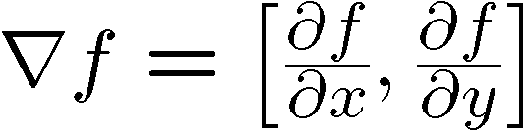



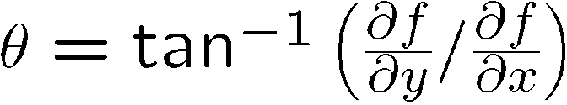
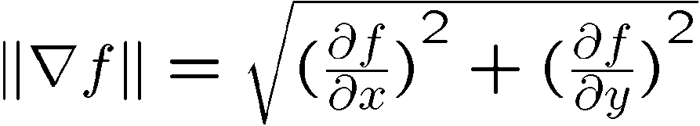
Gradient
Gradient equation:
Represents direction of most rapid change in intensity
Gradient direction:
The edge strength is given by the gradient magnitude
Notes:
Gradient = decides whether the intensity values reduce or increase when moving in a particular direction.
gradient direction is perpendicular to edge
gradient is the change in gray level with direction. This can be calculated by taking the difference in value of neighboring pixels.
𝛻 f means gradient / del
Direction is perpendicular to edge
Last: magnitude of the edge
The first is the derivative of the image with respect to x �, while the second is the derivative of the image with respect to y �.

Slide 10
Sobel Filter
The Sobel filter is used for edge detection.
It works by calculating the gradient of image intensity at each pixel within the image. It finds the direction of the largest increase from light to dark and the rate of change in that direction.
The result shows how smoothly the image changes at each pixel, and therefore how likely it is that that pixel represents an edge.
Notes:
Vertical and hor. Edges
Steep change (big difference) and shallow change

Slide 11
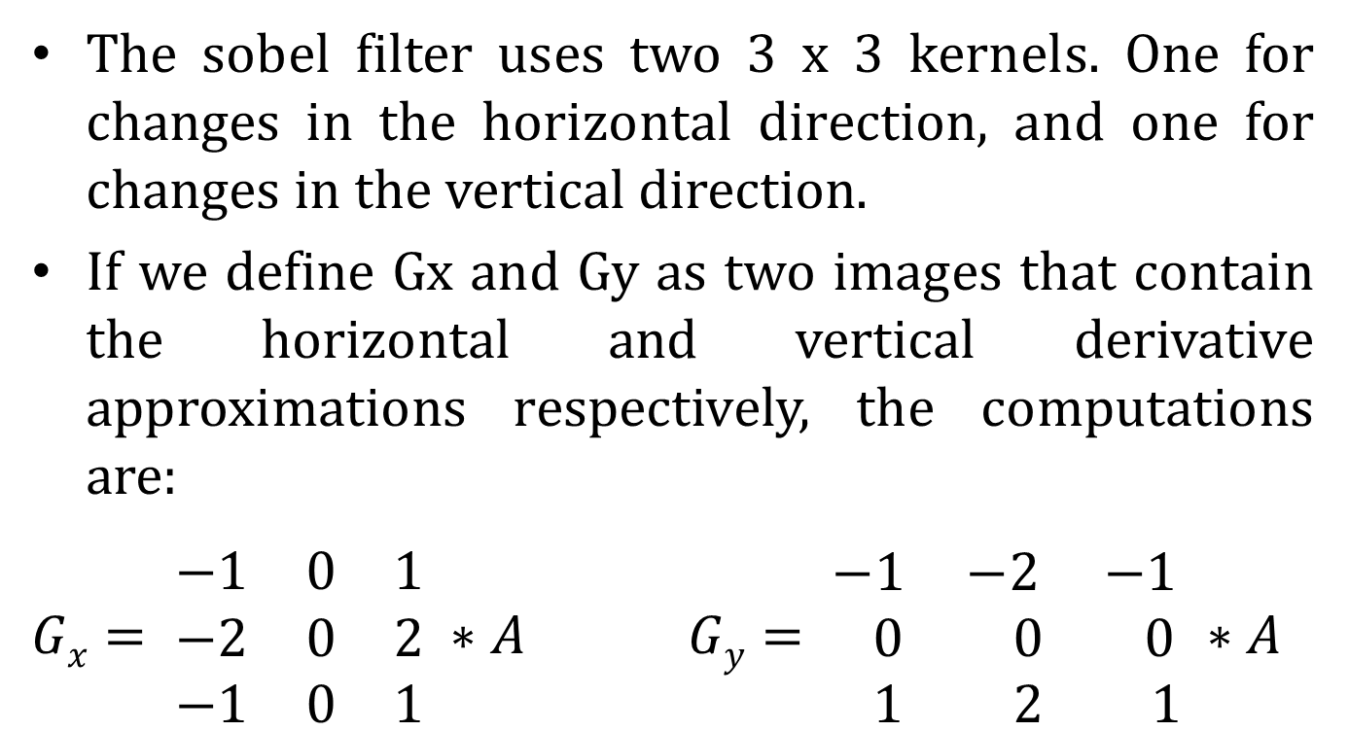
Sobel Filter
The sobel filter uses two 3 x 3 kernels. One for changes in the horizontal direction, and one for changes in the vertical direction.
If we define Gx and Gy as two images that contain the horizontal and vertical derivative approximations respectively, the computations are:
$Gx= \begin{matrix}−1 & 0 & 1 \\ −2 & 0 & 2 \\ −1 & 0 & 1\end{matrix} ∗A$ $Gy= \begin{matrix}−1 & −2 & −1 \\ 0 & 0 & 0 \\ 1 & 2 & 1\end{matrix} ∗A$
Notes:
* Refers to the pixel wise multiplication

Slide 12
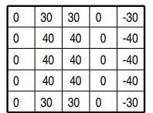

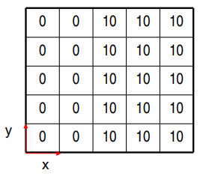
Sobel Filter - Example
Compute Gx and Gy, gradients of the image performing the convolution of Sobel kernels with the image.
0 | 10 | 30 | 40 | 30
0 | 0 | 0 | 0 | 0
0 | 0 | 0 | 0 | 0
0 | 0 | 0 | 0 | 0
0 | -10 | -30 | -40 | -30

Slide 13
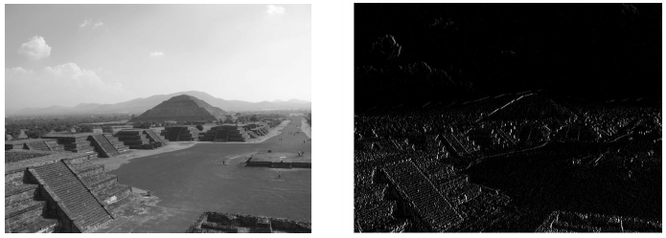
Sobel Filter
The image to the right below is G_{x}

Slide 14
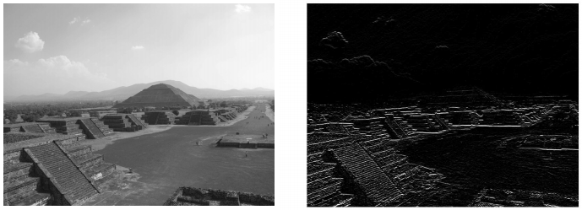
Sobel Filter
The image to the right below is G_{y}

Slide 15
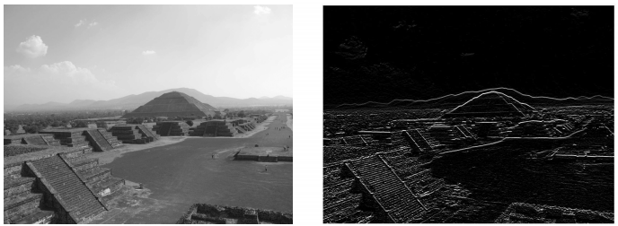
Sobel Filter
Result of combining the G_{x} and G_{y}

Slide 16
Steps in Edge Detection
Noise Smoothing: Suppress as much of the image noise as possible.
Edge Enhancement: Design a filter responding to edges. The filter’s output is large at edge pixels and low elsewhere. Edges can be located as the local maxima in the filters’ output.
Edge Localization: Decide which local maxima in the filter’s output are edges and which are just caused by noise.

Slide 17
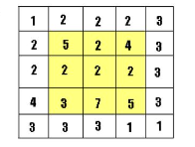

Quiz - 2
Compute Gx and Gy, gradients of the image performing the convolution of Sobel kernels with the image.
A
$Gx= \begin{matrix}−1 & 0 & 1 \\ −2 & 0 & 2 \\ −1 & 0 & 1\end{matrix} ∗A$
$Gy= \begin{matrix}−1 & −2 & −1 \\ 0 & 0 & 0 \\ 1 & 2 & 1\end{matrix} ∗A$

